Slide 1

Library Management System
Presented by
Saroar Zahan Sojib
Course Code: CSE 302
Course Title: Database lab

Slide 2
Content
Motivation
Project Objectives
Project Overview
Introduction
E-R diagram
Project Implementation
SQL code with example using realistic data
Limitations
Conclusion
References

Slide 3
Motivation
It provides fast tracking of material
Increased Consistency
Reduce workforce to maintain library resources
Less expensive because only once you need to spend money on system
No duplication of records
Occupy less space as for paper based system there should be separate space to keep them
Security of the system by authorizing access to limited people according to their rights

Slide 4
Objectives
The objectives of this project are to provide a database management system for school library which will help
to minimize the duplication of data
get rid from paper filling system
makes the processing of data very easy without waste of time
Following are the facilities:
Librarian: can find if the book is available or not its status and how much fine is due
Member: can borrow & return books and can leave and join library

Slide 5

Project Overview

Slide 6
Introduction
Library database system is designed to maintain the library assets in a suitable way.
Members of the library can keep track on availability of books, information about membership either they are student or staff of school, they can join or leave library and some responsibilities of librarians are added.
The core goals of this project are to define the entities, attributes and their relationship to create a database that can be easily managed by admin.

Slide 7
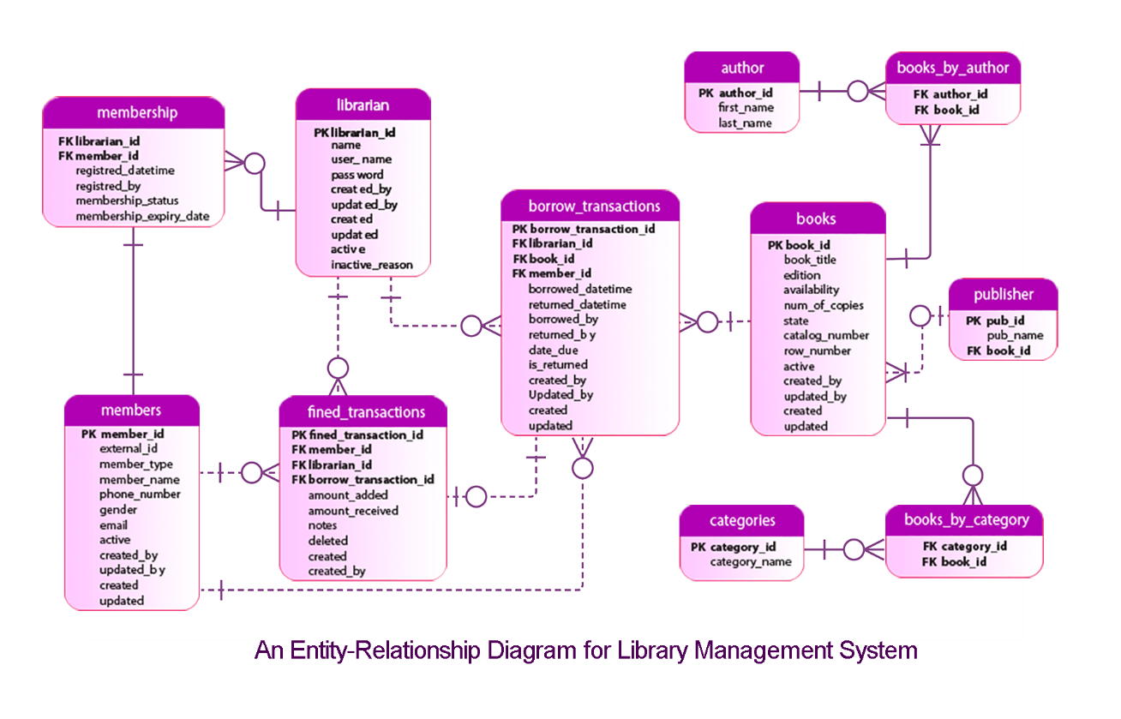
E-R Diagram

Slide 8
Entity Set
books
members
membership
borrow_transaction
librarian
fined_transaction
author
books_by_author
categories
books_by_category
publisher

Slide 9
Entity Set
SQL Code to Create Table
books
members
membership
borrow_transaction
librarian
fined_transaction
author
books_by_author
categories
books_by_category
publisher
CREATE TABLE books (
book_id INTEGER NOT NULL,
book_title VARCHAR(40),
edition VARCHAR(40),
availability BOOL,
num_of_copies INTEGER,
state VARCHAR(40),
catalog_number INTEGER,
row_number INTEGER,
active BOOL,
created_by VARCHAR(40),
updated_by VARCHAR(40),
created DATETIME,
updated DATETIME,
PRIMARY KEY (book_id)
);

Slide 10
Data Insertion into Entity Set
Table: books
INSERT INTO books (book_id, book_title, edition, availability, num_of_copies,state, catalog_number, row_number, active, created_by, updated_by, created, updated)
VALUES (101,'Numerical Methods For Engineer','4th',1,10,'EXCELLENT',3,4,1, 'KAUSHIK','APU','2016-10-12 12:10:03','2017-10-12 12:10:03'),
(102,'Discrete Mathematics And Its Application','7th',1,15,'EXCELLENT', 5,6,1,'KAUSHIK','APU','2016-12-10 12:10:03','2018-10-12 12:10:03');

Slide 11

Some Entity Set
Table: members
Table: publisher

Slide 12




Some Entity Set
Table: author
Table: books_by_author
Table: books_by_category
Table: categories

Slide 13
Query Implementation on Entity Set
To find publisher name of a book
SELECT books.book_title, publisher.pub_name
FROM books
INNER JOIN publisher on books.book_id=publisher.book_id;
Some other functions
SELECT member_type, member_name from members WHERE member_type!='student';
SELECT member_name,member_type,gender
FROM members ORDER BY member_name DESC;
SELECT book_title
FROM books;

Slide 14
Query Implementation on Entity Set
Using triggers
CREATE TABLE members_audit (
serial_no INT AUTO_INCREMENT PRIMARY KEY,
member_id INT NOT NULL,
new_name VARCHAR(50) NOT NULL,
old_name VARCHAR(50) NOT NULL,
updated_by VARCHAR(50) NOT NULL,
updated DATETIME DEFAULT NULL,
action VARCHAR(50) DEFAULT NULL
);
DELIMITER $$
CREATE TRIGGER after_members_update
after UPDATE ON members
FOR EACH ROW
BEGIN
INSERT INTO members_audit
SET action = 'update',
member_id = OLD.member_id,
new_name = new.member_name,
old_name = old.member_name,
updated_by = USER(),
updated = NOW();
END
$$ DELIMITER ;

Slide 15
Query Implementation on Entity Set
Using triggers
UPDATE members
SET member_name = 'Nafisa Anjum'
WHERE member_id = 18102;
SELECT *FROM members_audit;

Slide 16
Limitations
Though computerized library systems are widely used because this is the world of technology and development so people preferred to use computer based systems rather than manual it has some limitations too. These limitations can be happen not only in these library management systems but also in any kind of software based system too.
Risk of hardware or software failure
Data can be crashed
Training required to understand the system
It required high conversion cost to transform file-based system into computer based system.

Slide 17
Conclusion
Using SQL code, database system has been designed for school library which can be used to store data regarding books, members of library and can also update, delete and add new records.
This database is designed with that flexibility that it can be implemented in any library in future.
It can be modified easily into new technology. We can add as many data as required.

Slide 18
References
"Entity Relationship Diagram - Everything You Need to Know About ER Diagrams", Smartdraw.com, 2018. [Online]. Available: https://www.smartdraw.com/entity-relationship-diagram/. [Accessed: 08- Apr- 2018].
"Online Diagram Software & Visual Solution | Lucidchart", Lucidchart, 2018. [Online]. Available: https://www.lucidchart.com/. [Accessed: 08- Apr- 2018].
"PL/SQL Triggers", www.tutorialspoint.com, 2018. [Online]. Available: https://www.tutorialspoint.com/plsql/plsql_triggers.htm. [Accessed: 08- Apr- 2018].
A. Silberschatz, H. Korth and S. Sudarshan, Database system concepts (Sixth edition).
R. Elmasri and S. Navathe, Fundamentals of database systems. 1272 Seiten: [s.n.], 2017.

Slide 19

Thank you

